Slide 1

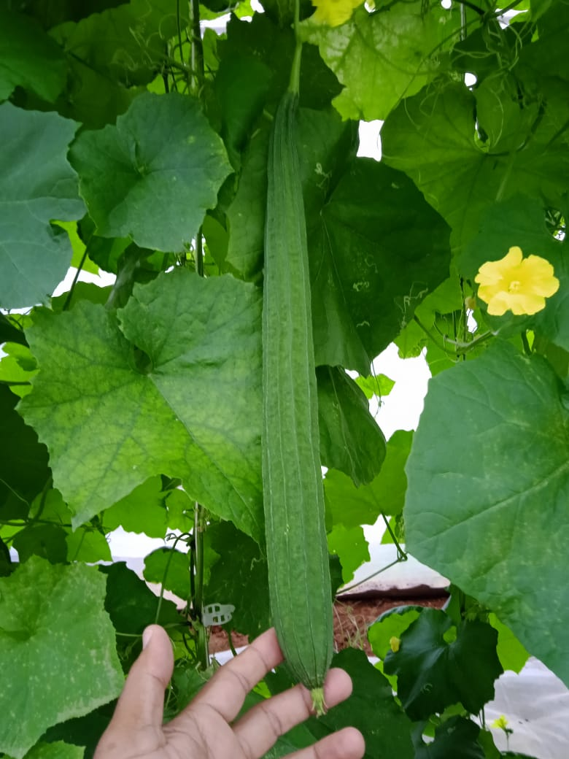
UNIVERSITY OF HORTICULTURAL SCIENCES, BAGALKOT
Global Conference On Smart Horticulture for Prosperity and
Nutritional Security (GCSH-2025)
Development an effective deep learning technique for the detection of
Early Stage of Downy Mildew disease in ridge gourd
Mangalanageshwari
Bachelor of Engineering
Electronics and Telecommunication

Slide 2
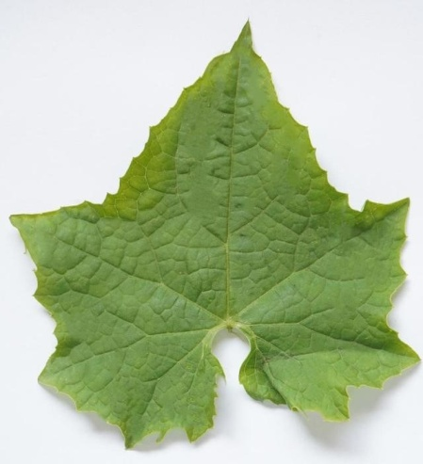
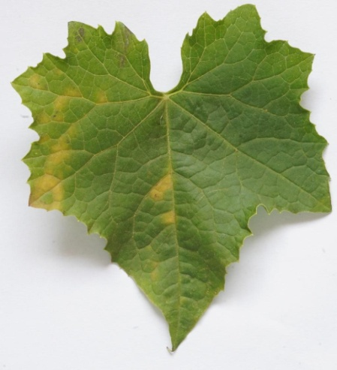
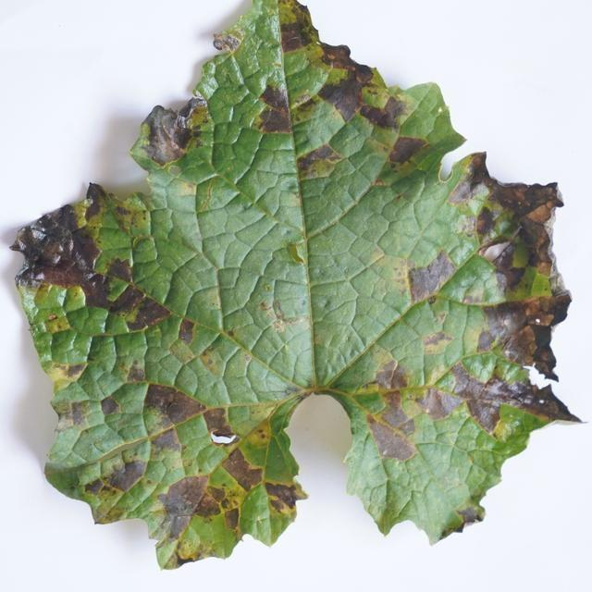
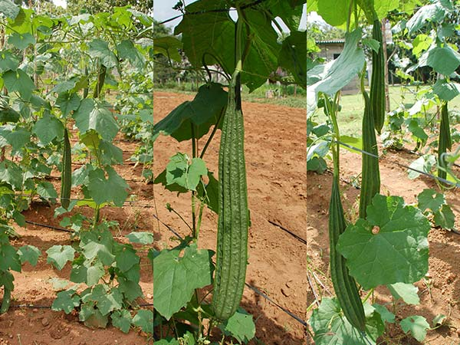
INTRODUCTION
Ridge gourd (Luffa acutangula) is a significant vegetable crop in India, valued for its nutritional and economic importance.
Ridge gourd is cultivating in 24,500 acres approximately in India with production of 3,16,925 tones .
Healthy leaf
Early Stage
final Stage
Downy mildew is a significant fungal disease affecting ridge gourd and other cucurbit crops worldwide, caused by the pathogen Pseudoperonospora cubensis .
Infected ridge gourd plants may experience up to 40-60% reduction in marketable yield due to downy mildew ..

Slide 3

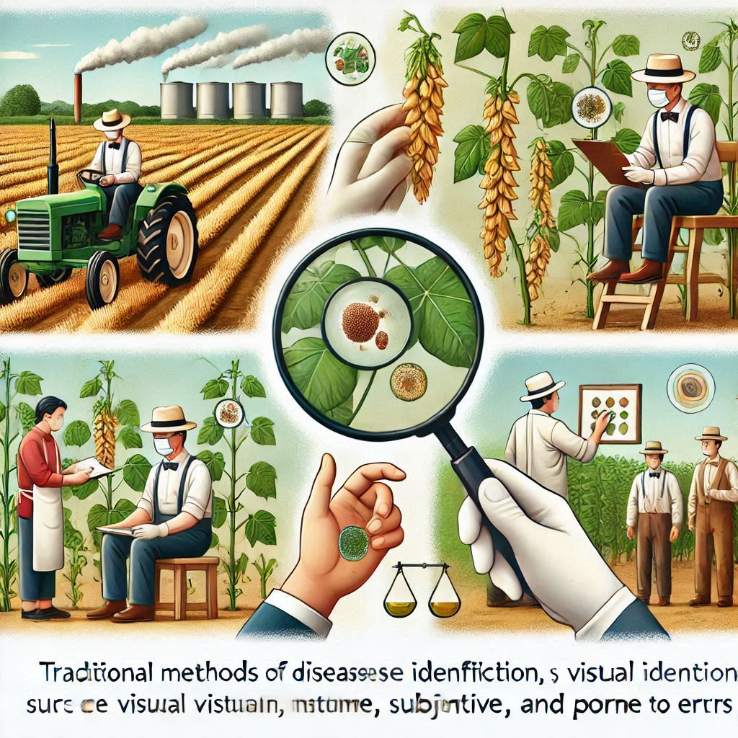
INTRODUCTION
Although downy mildew symptoms like yellow patches on leaves are distinct and easy to identify, early or mild symptoms can still be missed during large-scale inspections, making traditional methods less practical .
Delays in detection often result in severe infections, requiring more intensive and environmentally harmful management measures .

Slide 4
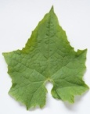




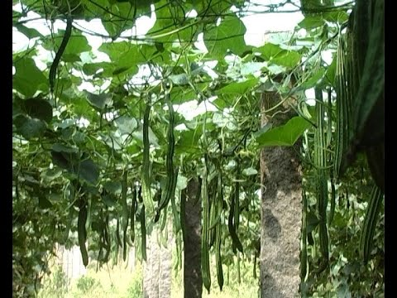
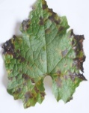
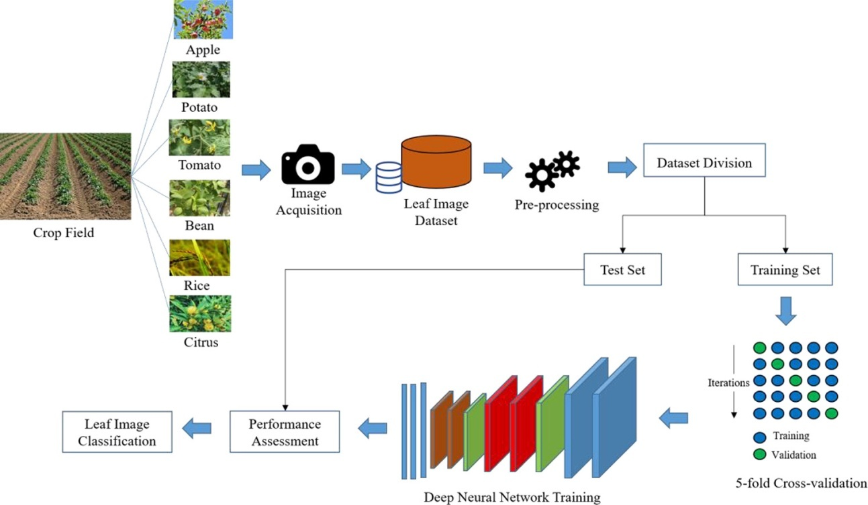
Methodology
Healthy
Dataset Division
Image
Acquisition
Leaf Image
Dataset
Pre-processing
Downy Mildew
Early
Test set
Train set
Crop Filed
Downy Mildew
Later
Leaf Image
Classification
Performance Assessment
Deep Neural Network Training
Hyper Parameter Tuning
Figure:1 Disease detection using deep learning model

Slide 5
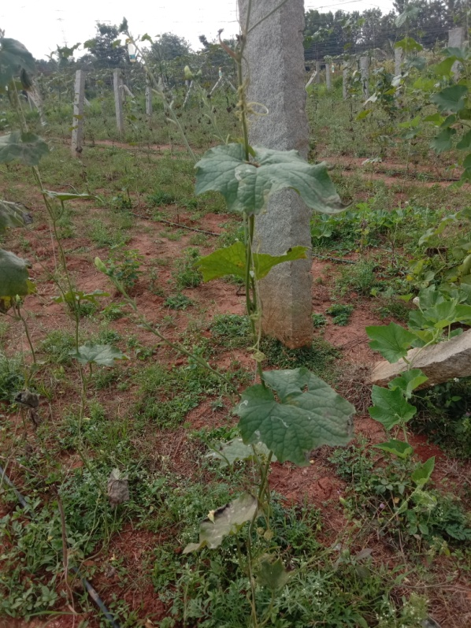
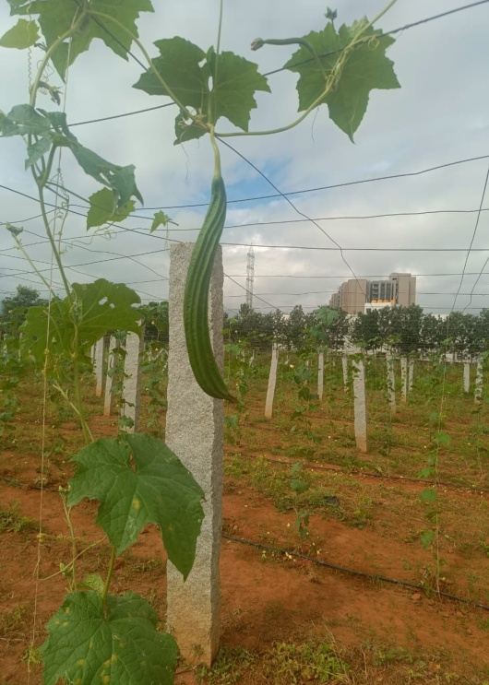
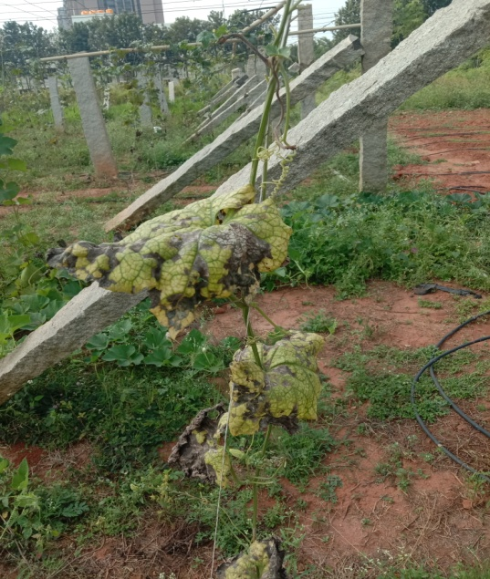
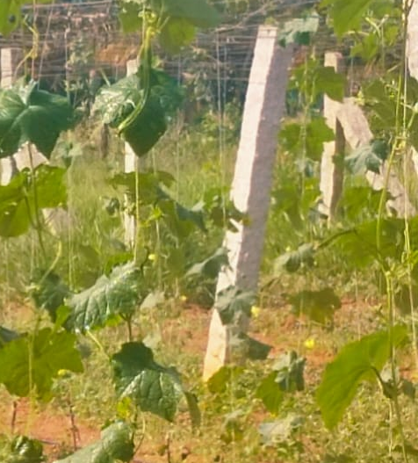
I. Data set collection
Images were collected from the experimental field located in RHREC,COH Bengaluru, under natural light using a Sony camera
Resolutions used were 4000*6000 pixel (2:3) and 6000*4000 pixel (3:2) for scale variation
The dataset included 2500 images of Ridge Gourd Downy Mildew (Initial Stage, Later Stage) and Healthy leaves.
It was split into 1750 images for training, 500 images for validation, and 250 images for testing.
Notes:
This resolution was set to capture the each and every symptoms of the disease and to capture in all angles

Slide 6
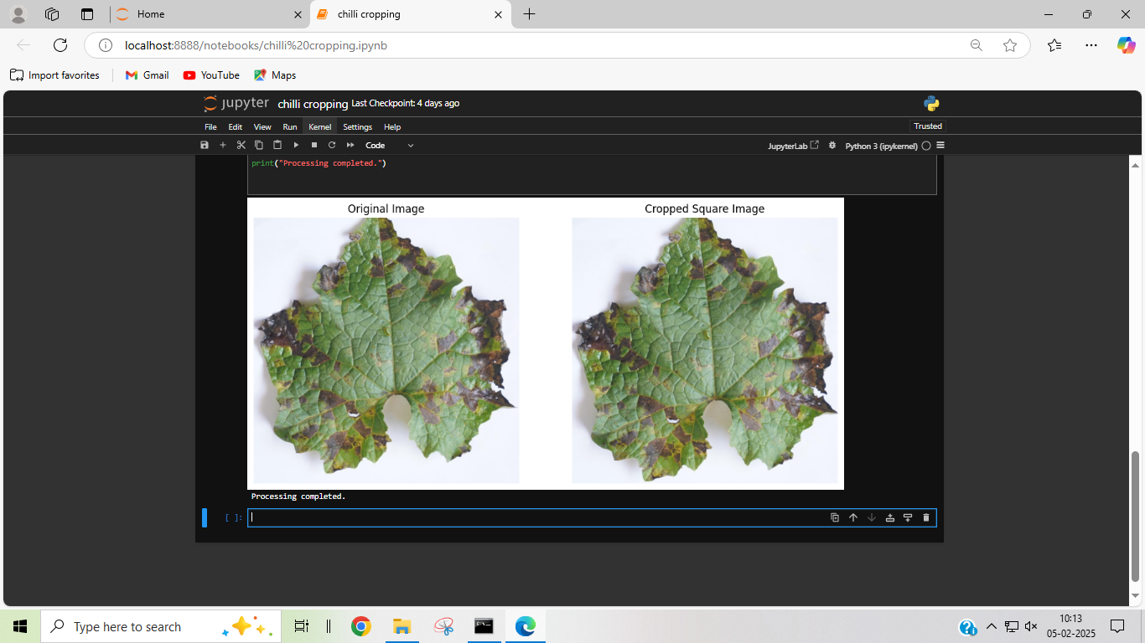
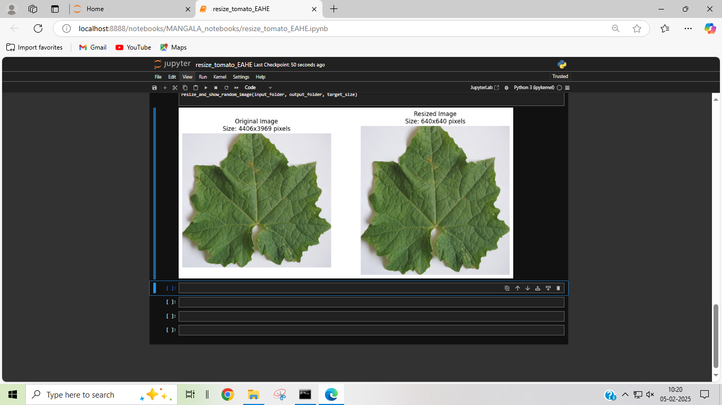
II. Pre-processing
1.Cropping: Images are cropped to focus on the affected areas, ensuring that the model learns to detect the disease in relevant portions of the plant leaves rather than unnecessary background.
2.Resizing: All images are resized to a uniform size of 640x640 to ensure consistent input dimensions for the model. This helps improve training efficiency and reduces computational complexity.

Slide 7
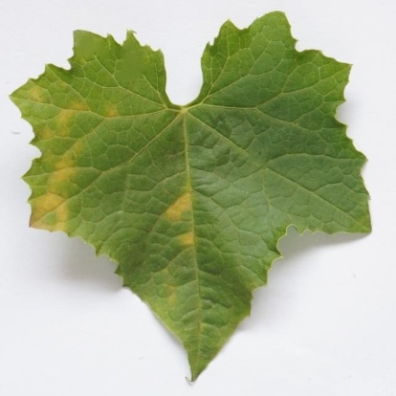
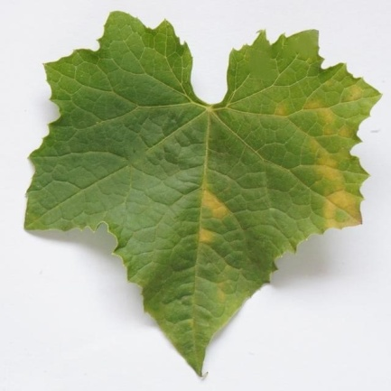
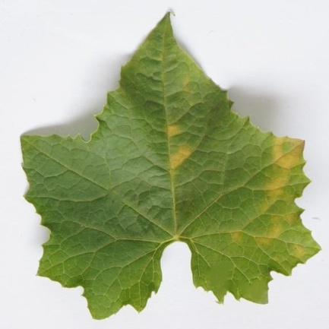
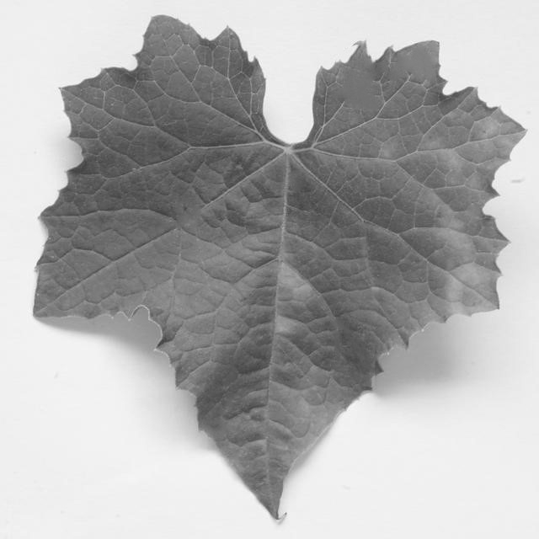
3.AUGMENTATION
Data augmentation is the process of artificially increasing the size of a dataset by applying transformations to existing data.
Purpose: Improves model performance and reduces over fitting.
Techniques Used:
Flipping
Grayscale conversion
Impact on Model Performance:
Expands the dataset without additional image collection
Enhances the model’s ability to detect disease under varied conditions
Original Image
Horizontal Flipped Image
Vertically Flipped Image
Gray Image

Slide 8
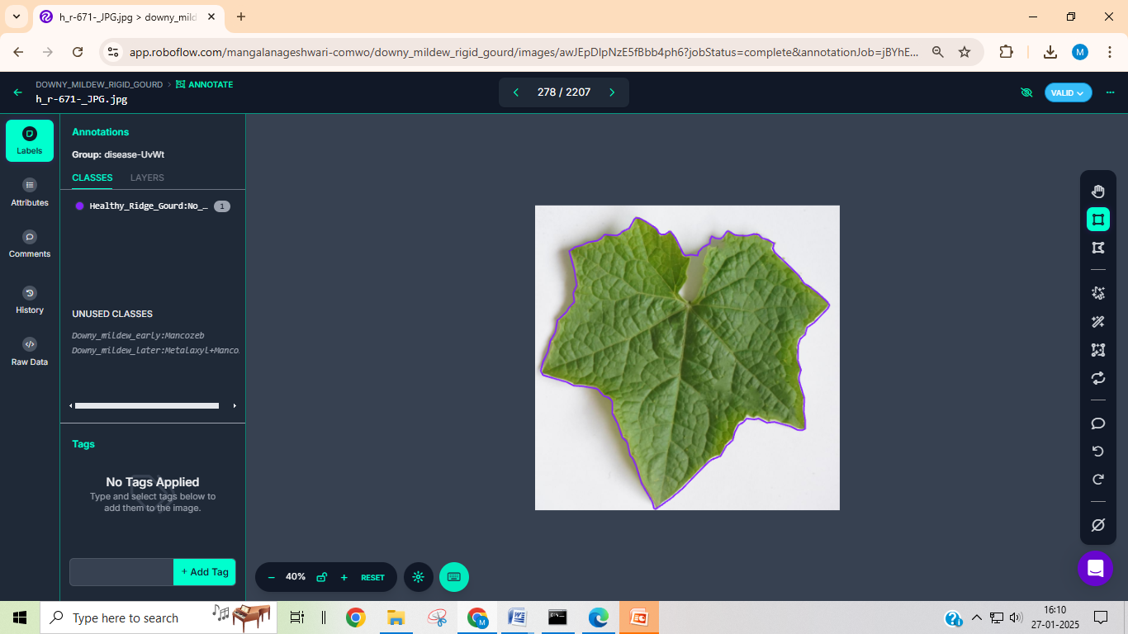
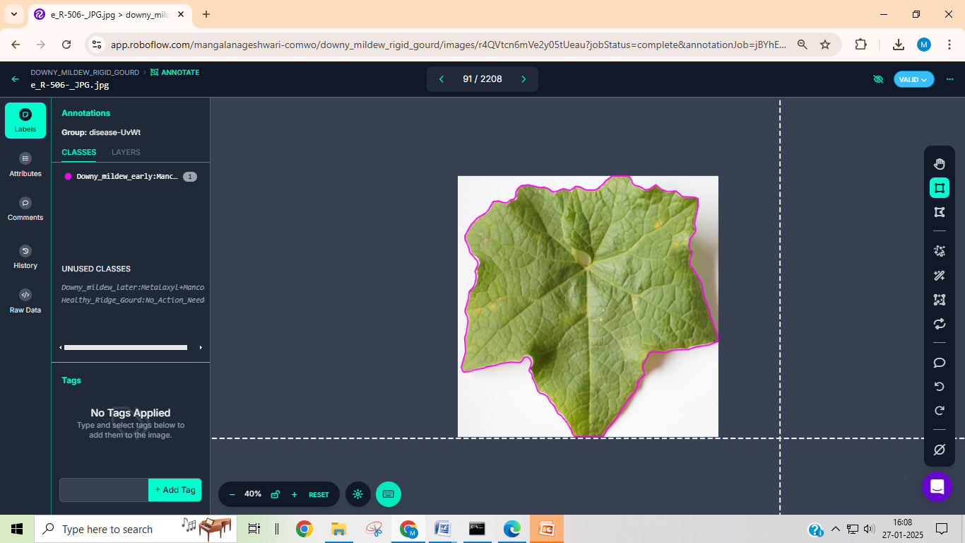
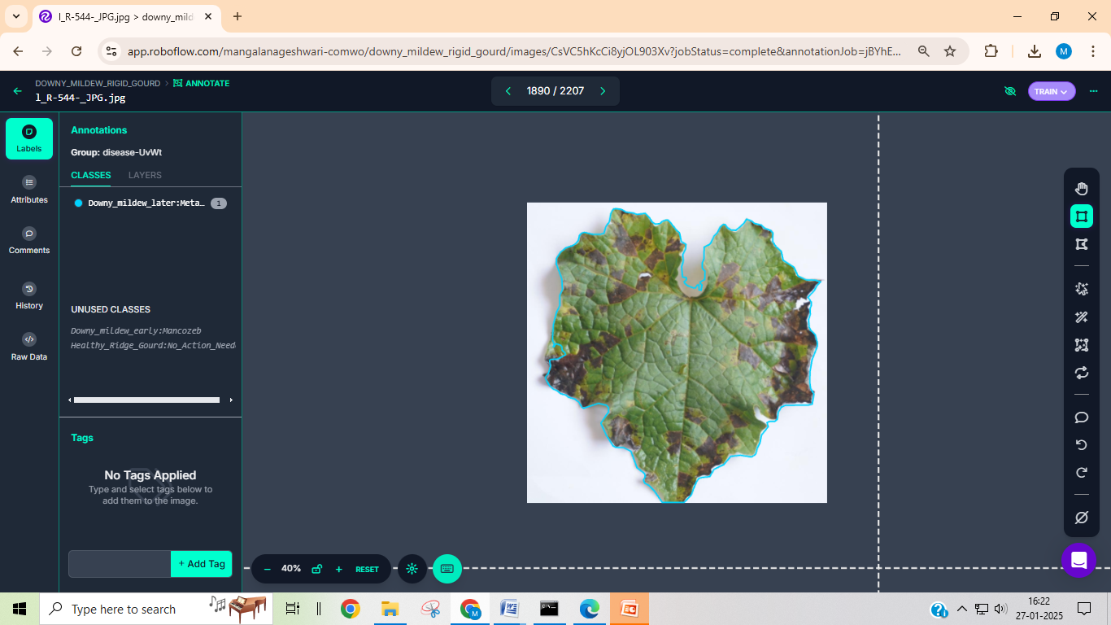
4.ANNOTATION
Annotation is the process of labeling data by adding meaningful information to help deep learning models learn patterns and make accurate predictions.
In deep learning, annotation involves marking specific regions in images to train models for object detection and classification.
Annotation Tool Used: (Roboflow)
Annotation Type: Polygon-based annotation for precise disease region labeling
Impact on Model Performance:
High-quality annotations improve disease detection accuracy
Helps deep learning models distinguish disease stages effectively
Labeled Categories:
Healthy Ridge Gourd Leaves
Downy Mildew (Intial Stage)
Downy Mildew (Final Stage)
.
Notes:
After data set collection all the images were manually annoted using Roboflow where bounding box were created around the symptomatic part and then this images are saved in YOLO formate

Slide 9
III. Training Labelled Images using DL technique
Hyper parameter Tuning
Adjust learning rate, batch size, and epochs using the validation set.
helps improve model accuracy and prevent over fitting.
Deep Neural Network Training Train the CNN model to identify disease patterns in leaf images.
Focuses on detecting key features of disease spots.
Performance Assessment
Test the model on a separate test set to check accuracy.
Evaluate Precision, Recall, F1 Score, True Positive Rate, and Confusion Matrix.
4. Leaf Image Classification
Train the model to classify leaves into:
Healthy
Downy Mildew (Early Stage)
Downy Mildew (Final Stage)
Notes:
Google is the open access working space used for carryout the traing process

Slide 10
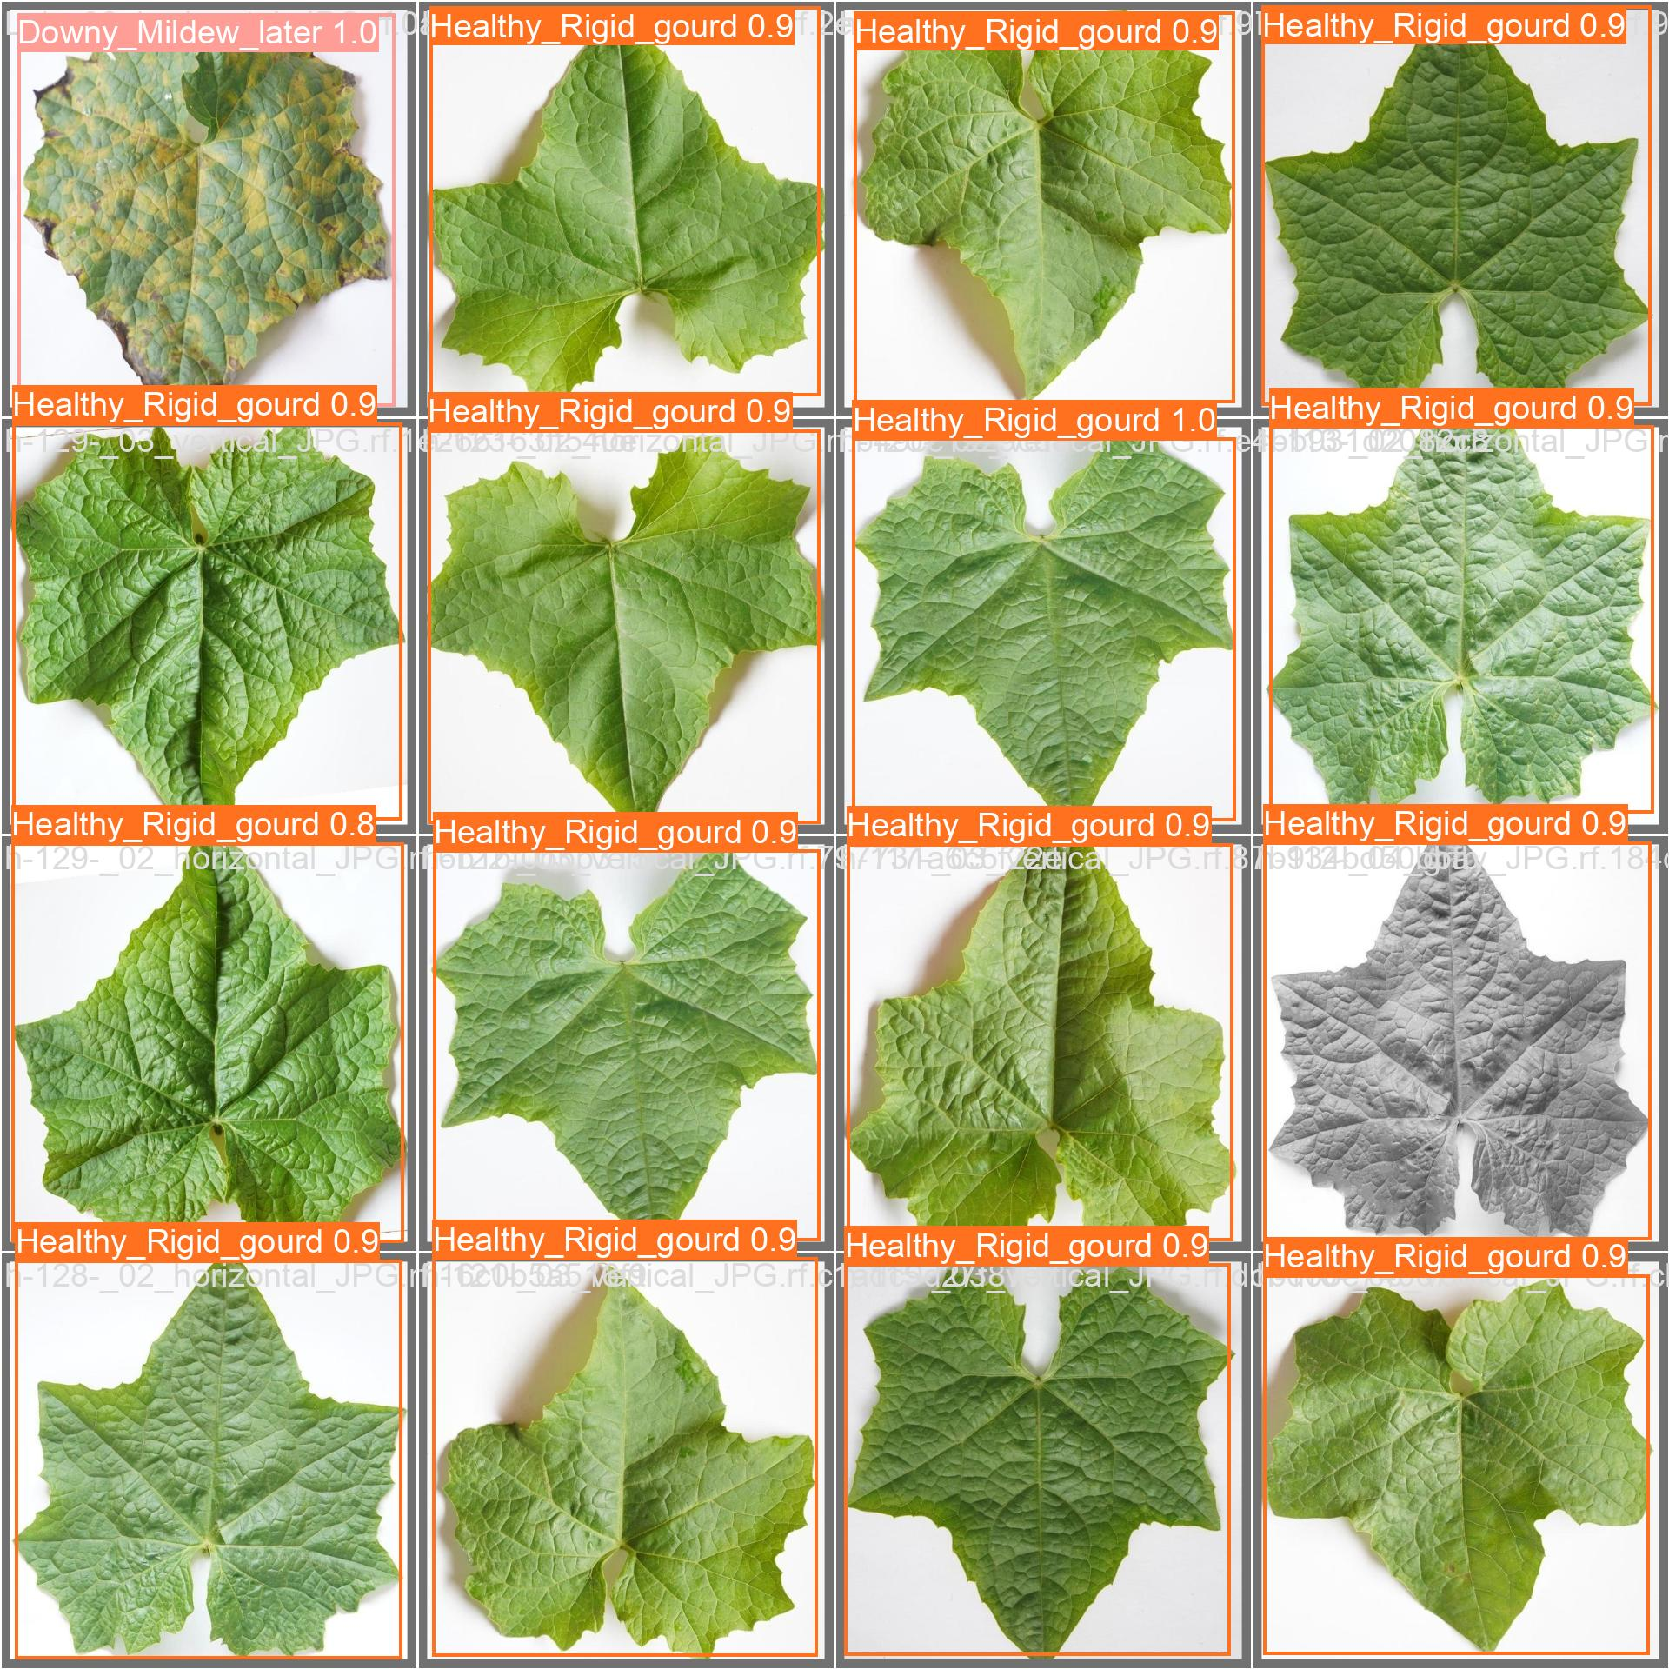
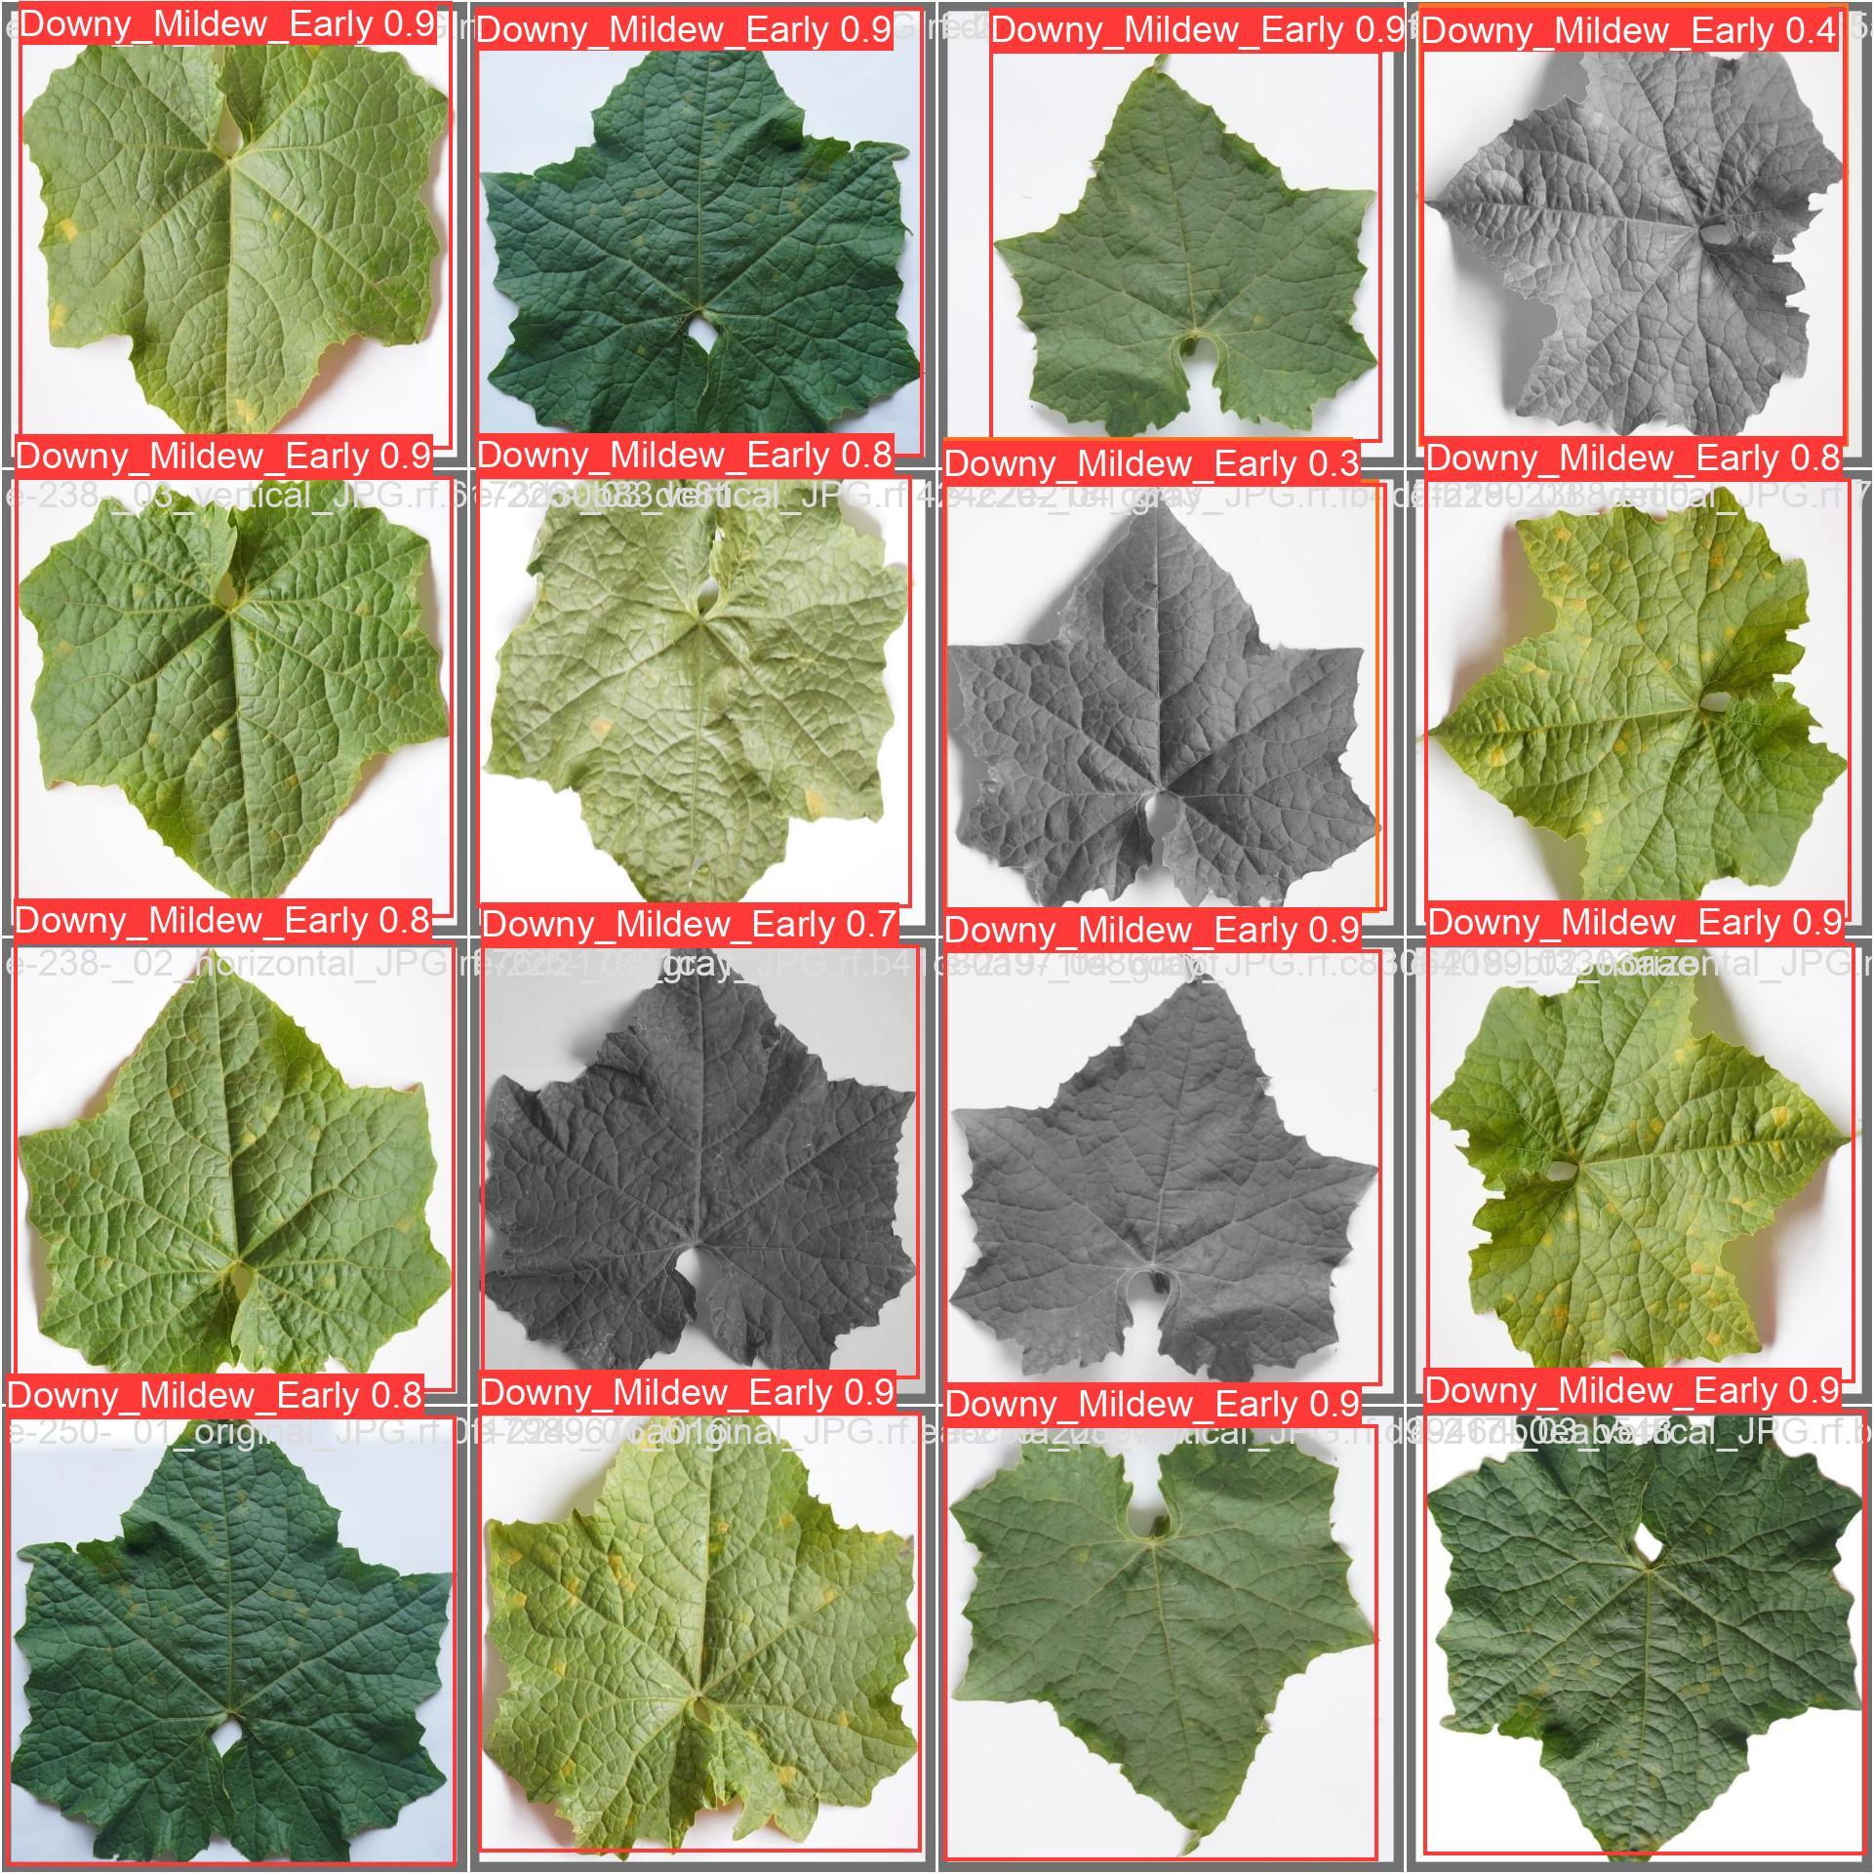
Figure 2. Training and validation batch data set of Downy mildew disease

Slide 11
Results
Table 1. Results after training
Metric | All Classes | Downy Mildew Initial | Downy Mildew Later | Healthy Ridge Gourd
Total Images | 2,500 | 730 | 750 | 800
Precision (P) | 0.962 | 0.978 | 0.957 | 0.952
Recall (R) | 0.976 | 0.935 | 0.992 | 1.000
mAP | 0.992 | 0.990 | 0.993 | 0.994
Detection Precision(%) | - | 95 | 97 | 99

Slide 12
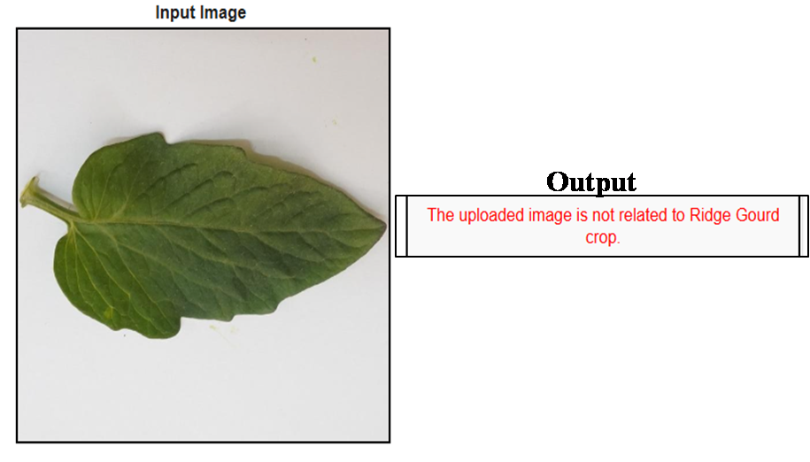
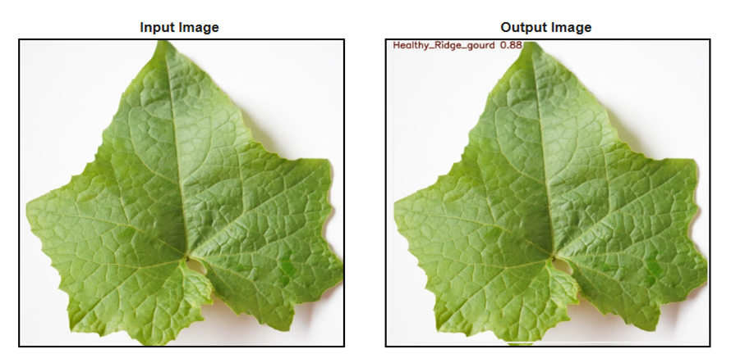
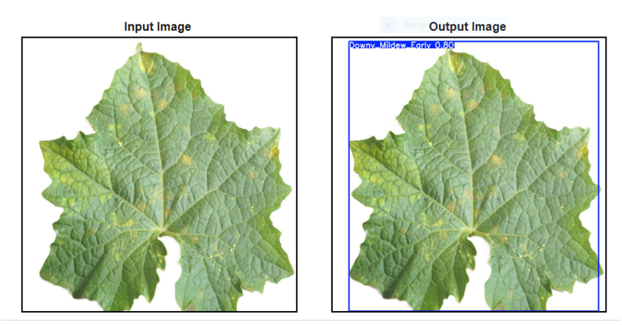
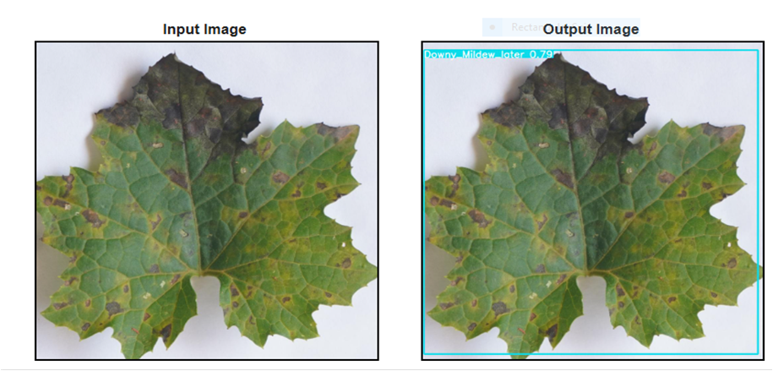
A
B
C
D
Fig. 1 (A) Other crop leaves detection (B) Healthy leaf detection (C) Initial stage downy mildew detection and (D) Final stage downy mildew detection

Slide 13
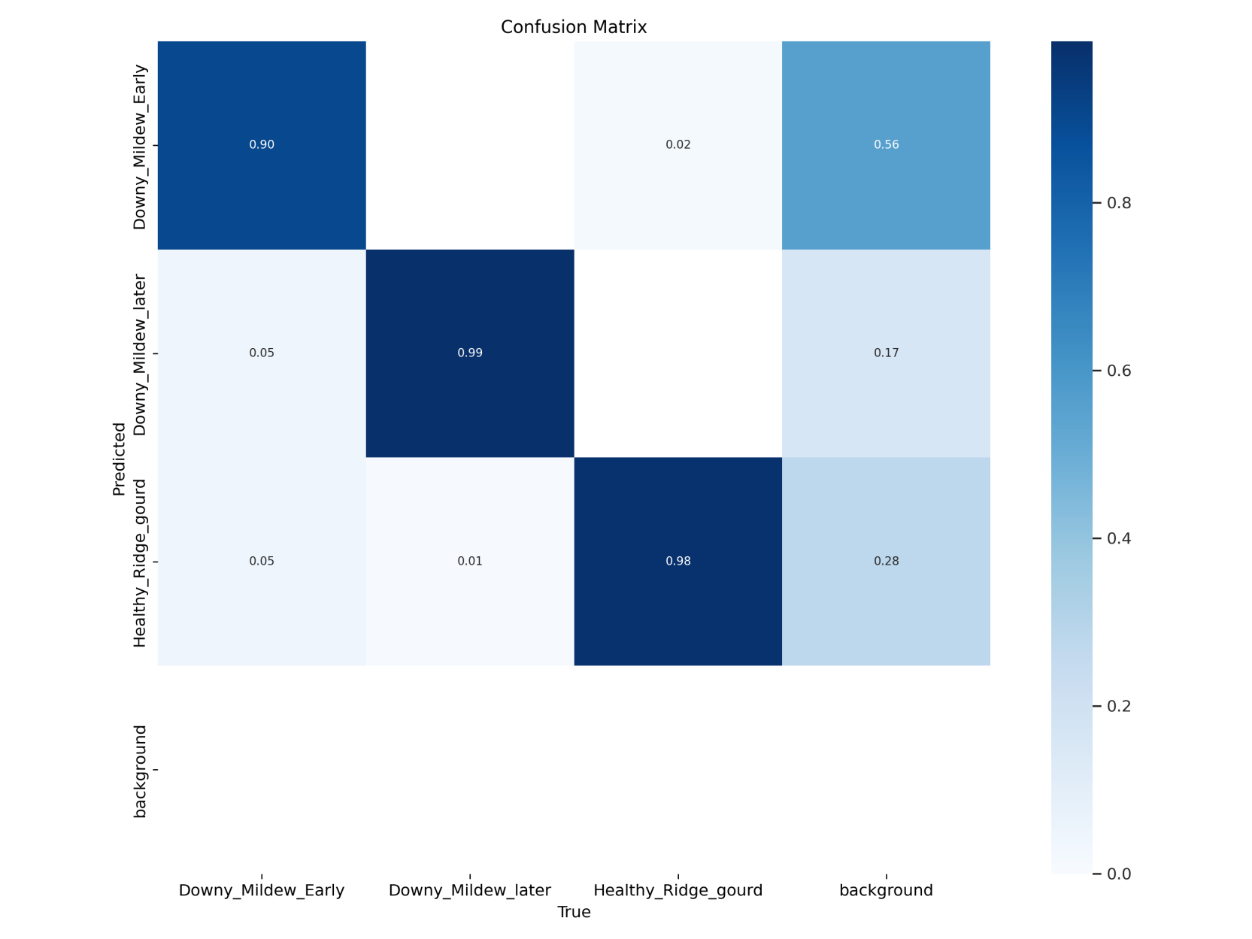
Plots
Fig. 2 Confusion matrix of YOLOv5 for detection of Downy mildew disease in ridge gourd

Slide 14
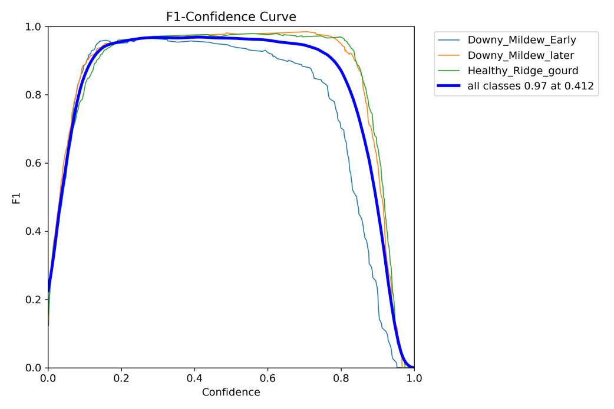
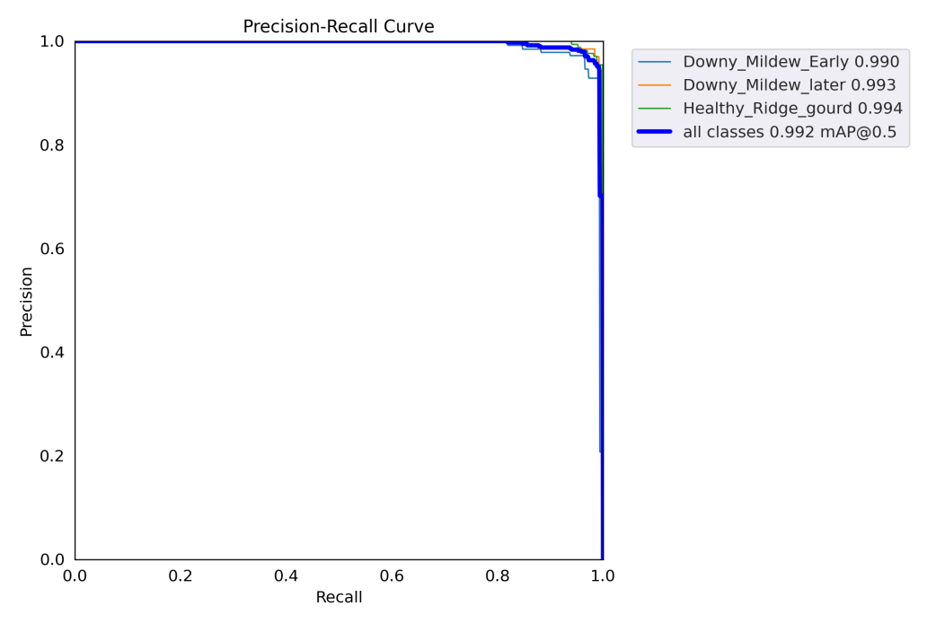
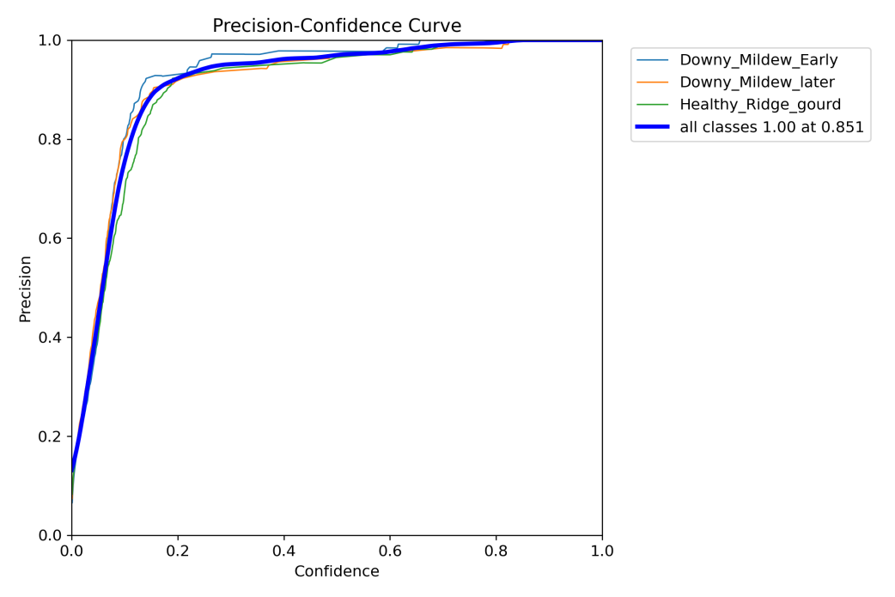
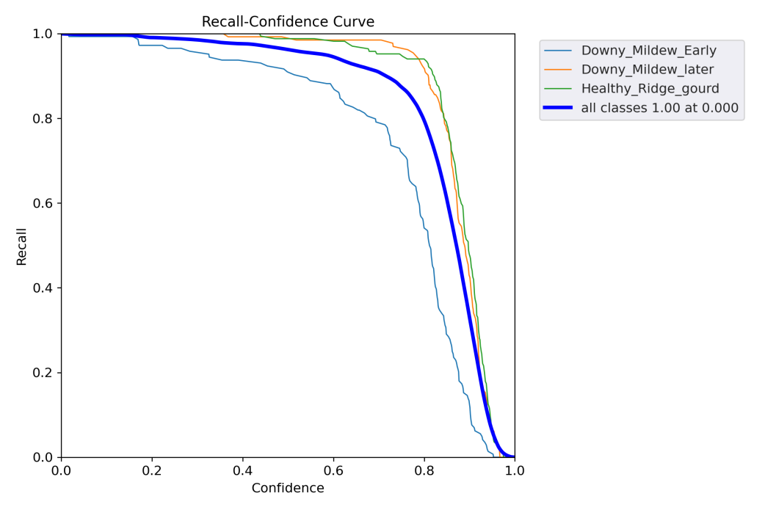
A
B
C
D
Fig. 3 (A) F-1 confidence curve (B) Precision recall curve (C) Precision-confidence curve and (D) Recall-confidence curve

Slide 15
References
Shodhan Jain, H. S., Vasudevan, S. N., Hanumantharaya, B. G., Vishwanath, K., & Marappa, N. (2023). "Comprehensive Assessment of Ridge Gourd [Luffa acutangula (L.) Roxb.] Genotypes for Growth and Seed Yield." The Pharma Innovation Journal, 12(12), Part J, 861-865.
Sundharaiya, K., Sriram, N., Sivakumar, V., & Sathish, G. (2022). "Integrated Crop Management Practices in Ridge Gourd Hybrid COH 1 for Increasing Yield and Income under Cuddalore District of Tamil Nadu, India." International Journal of Plant & Soil Science, 34(22), 871-876.
Chen, X., Wang, R., Yuan, Z., Chen, S., & Zou, X. (2022). "Plant Disease Recognition Model Based on Improved YOLOv5." Agronomy, 12(2), 365.

Slide 16
Conclusion
High accuracy (99%) was achieved in identifying healthy ridge gourd leaves.
Accuracy for downy mildew-infected leaves was slightly lower at 95% for early stage and 97% for later stage, with occasional misclassifications.
The deep learning-based detection model for downy mildew in ridge gourd achieved a mean Average Precision (mAP) of 0.992 at 0.5.

Slide 17


